Slide 1
License plate detection using Image Segmentation and OCR
Link to paper - Automatic Number Plate Detection
Paradoxicals
Alok Dhar Dubey
Hardik Kalra
Nidhi
Sayantika Sengupta

Slide 2
Introduction
Recognizing a Car License Plate is a very important task for a camera surveillance-based security system. We can extract the license plate from an image using some computer vision techniques and then we can use Optical Character Recognition to recognize the license number. Here we will guide you through the whole procedure of this task.

Slide 3
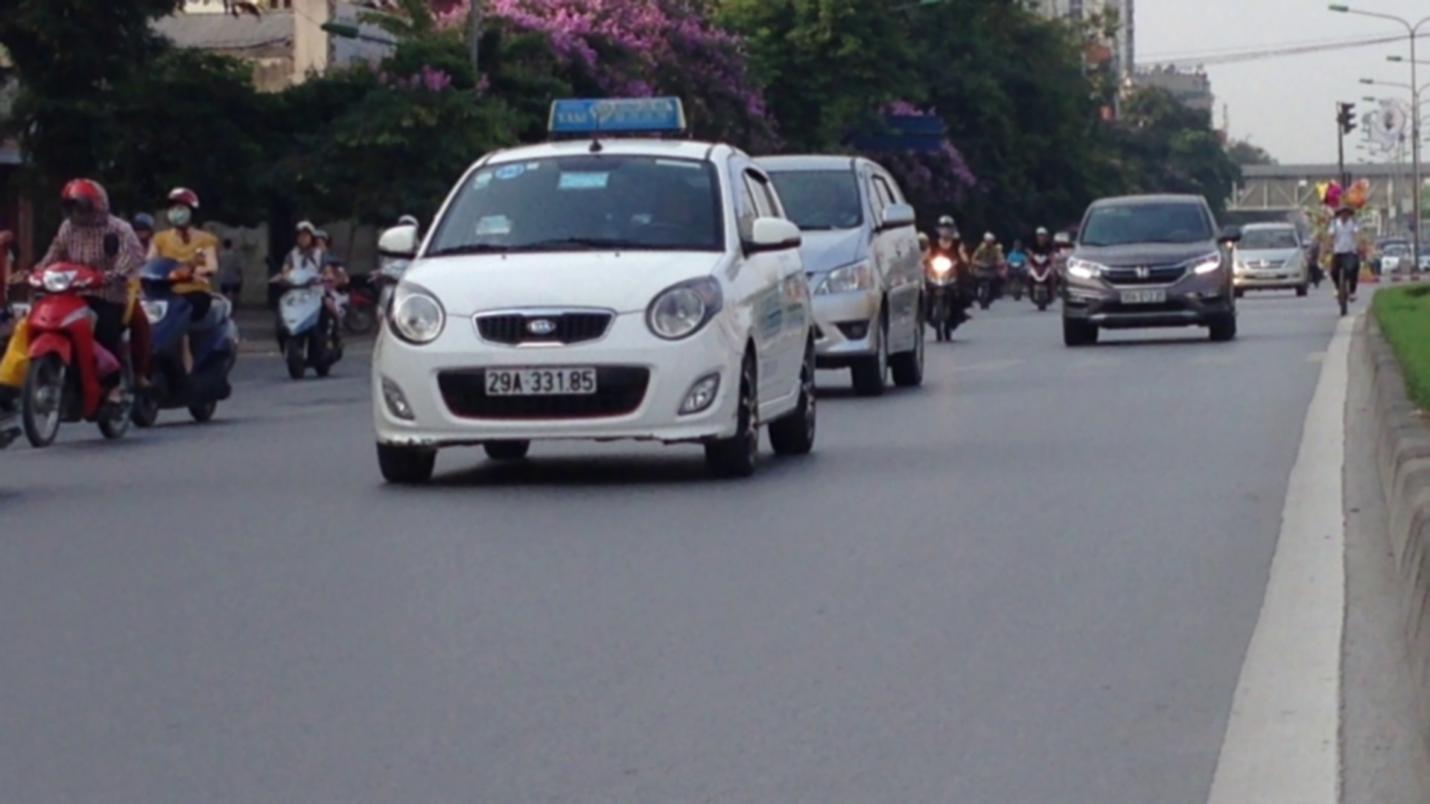

Example
INPUT:
OUTPUT:

Slide 4
Our Approach:
Find all the contours in the image.
Find the bounding rectangle of every contour.
Compare and validate the sides ratio and area of every bounding rectangle with an average license plate.
Apply image segmentation in the image inside the validated contour to find characters in it.
Recognize characters using an OCR.

Slide 5


METHODOLOGY

Slide 6
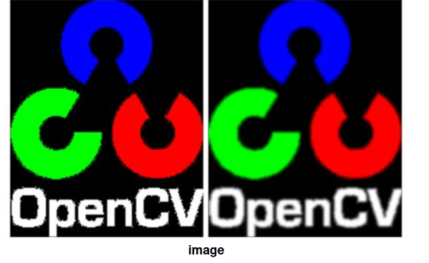
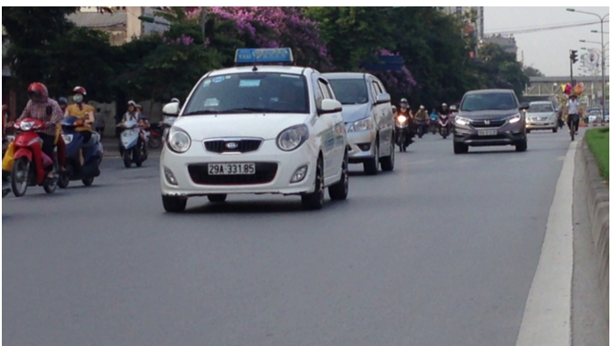
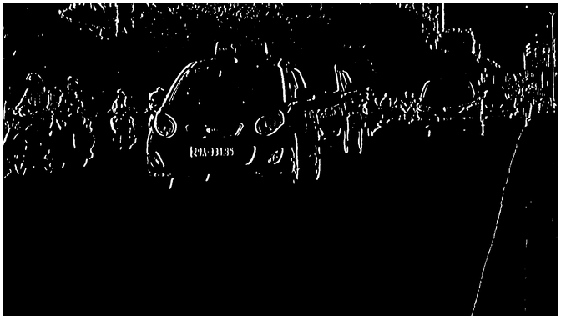
STEP - 1 and 2
Blurring/ smoothing the image
Every image contains noise. Blurring or smoothing of an image reduces the noise in a picture.
In our implementation we have used Gaussian blurring.
Here is an example of Gaussian blurring.
Preprocessing of the smoothed image
We convert the smoothed image to grayscale.
We find the vertical edges of that image.
Let us see the before and after images:

Slide 7
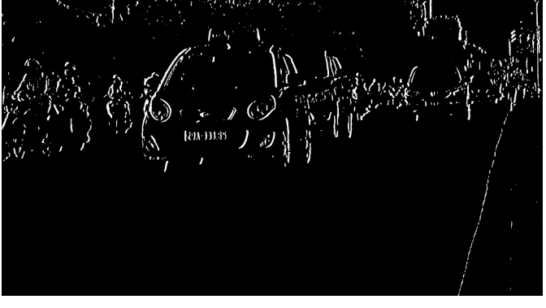
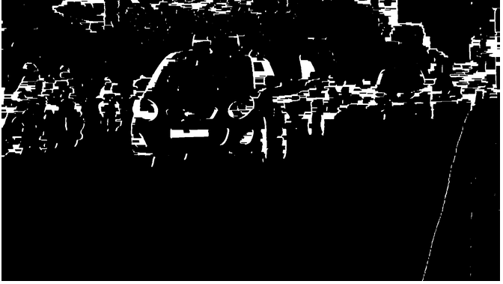
STEP - 3 and 4
Otsu’s Thresholding:
Binarizing the image: reducing data to binary form
We use Otsu’s thresholding (because we don’t have to specify the threshold)
Closing morphological Transformation:
Closing is useful to fill small black regions between white regions in a thresholded image.
Thus we get the full license plate, without the black spaces in between.

Slide 8

STEP - 5 and 6
Contouring:
Contours can be explained simply as a curve joining all the continuous points (along the boundary), having same color or intensity.
Binarization and morphing helps reducing the number of contours in an image.
Finding the license plate contour:
.Now find the minimum area rectangle enclosed by each of the contours and validate their side ratios and area.
find the contours in the validated region
validate the side ratios and area of the bounding rectangle of the largest contour in that region
We are left with a perfect contour of a license plate.

Slide 9
STEP - 7
Optical Character Recognition (OCR)
Final step is to detect each character of number plate
A pre-trained MobileNet model is used for this purpose
Transformer and other SOTA models could perform better, but not suitable for real-time usage
A standard VisionEncoderDecoder model will be around 2-3 GB large
On the their hand, this model takes only around 5 MB of storage
Model specification
The model is trained as a classification model, with 14 labels
0 to 9 digits and characters A, C, E and F as classes
Specifically trained for Vietnamese license plates

Slide 10
Final Step
SEGMENTATION
Image segmentation is a process that basically divides the image into multiple classes depending on their intensity.
Apply adaptive thresholding on the plate’s value channel image to binarize it and reveal the characters.
After binarizing apply bitwise not operation on the image to find the connected components
Construct a mask to display all the character components and then find contours in the mask.
After extracting the contours take the largest one, find its bounding rectangle and validate side ratios.
find the convex hull of the contour and draw it
find all the contours in the character candidate mask and extract those contour areas

Slide 11
IMPLEMENTATION OF THE MODEL
to
IN REAL LIFE
Social implementation: We can use this method to create a database of cars in a certain region.
Crime detection: We can use this technology to easily track the traffic rule-breaking that occured in a certain area.

Slide 12
Possible Improvements
to
We could have used other models like transformers or other more accurate models for OCR.
Even the license plate detection could also be done by finetuning some other existing pre-trained model like YOLO.
But our approach is easy to train and can be run easily on mobile phones also. Which makes it more user friendly.

Slide 13
Code Walkthrough

